Slide 1
The First 20 Elements
Reading The Periodic Table

Slide 2
Chemistry Basics
All of the matter in the universe (what we call “stuff”) is made of just about 100 different kinds of atoms.
Everything in your world is made up of simple combinations of these basic building blocks called atoms.
Chemistry is the study of how these atoms combine and the products they create.

Slide 3
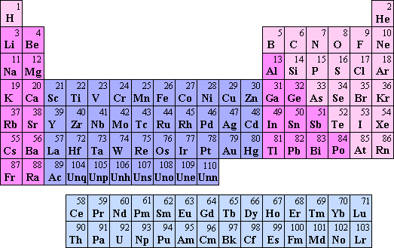
The Periodic Table
Contains almost all of the information about all of the elements on one page.

Slide 4
Reading The Periodic Table
Each box on the periodic table represents a different element
It contains vital information about the element
Atomic Number
6 C Carbon 12.011
Element Symbol
Element Name
Atomic Mass

Slide 5
Reading The Periodic Table
Each box on the periodic table represents a different element
It contains vital information about the element
Atomic Number
6 C Carbon 12.011
Element Symbol
Element Name
Atomic Mass

Slide 6
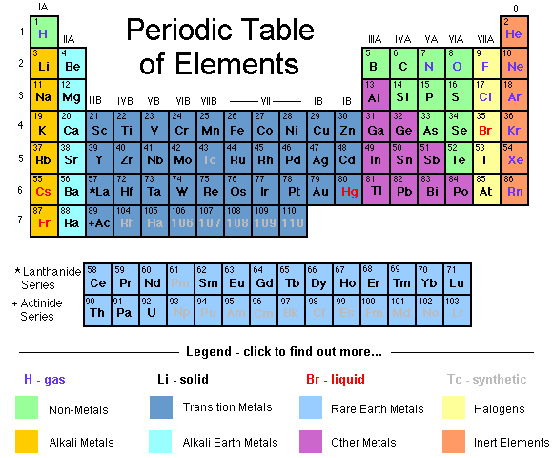

Slide 7
Practice:
Warm-up Questions:
Element name for the symbol “P”
Symbol for the element “Potassium”
Atomic number for the symbol “Ag”
Atomic mass for “Gold”
First 20 Elements Worksheet
Only complete Day #1 information:
Number, Symbol, Name, & Atomic Mass
Questions #1, #2

